Slide 1

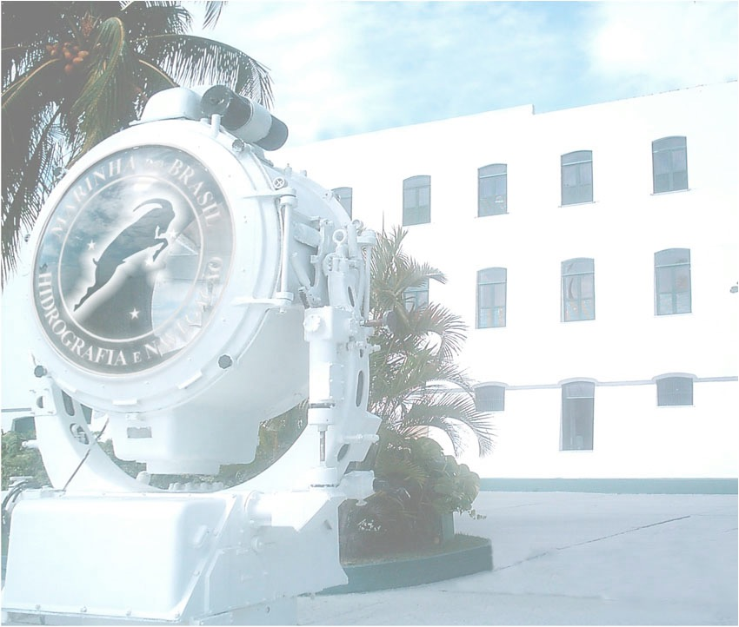
Brazilian Navy Hydrography Center
HYCOM OCEAN MODEL: an evaluation applied to SAR operations
Thiago Zamith Cunha
E-mail :zamithcn@gmail.com
Contact: +55 21972858424
Notes:
1

Slide 2
Summary
About SAR operations
HYCOM-CHM Model as a auxiliar decision tool
3. The Case Study
4. Present and Future
5. Conclusion
6. Referencies

Slide 3
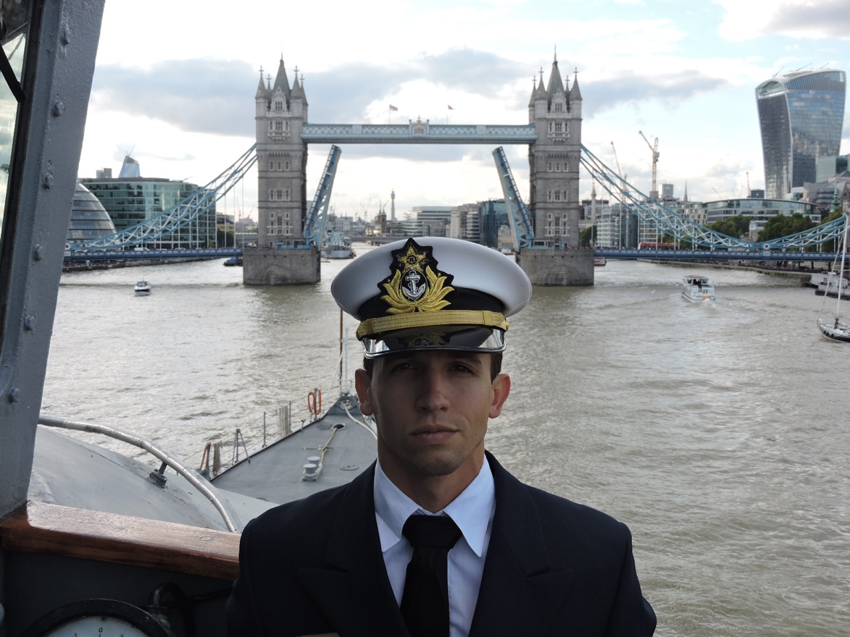
About me...
Navy Officer (DHN)
Data Scientist
Drift of things in the ocean...
Eternal student

Slide 4
About SAR operations
A large coast with differents climatologies
Time is the key...
SAR areas
IAMSAR – IMO/ICAO

Slide 5
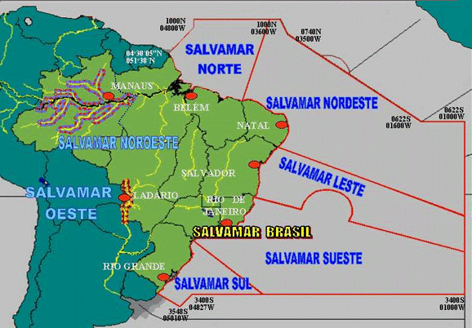
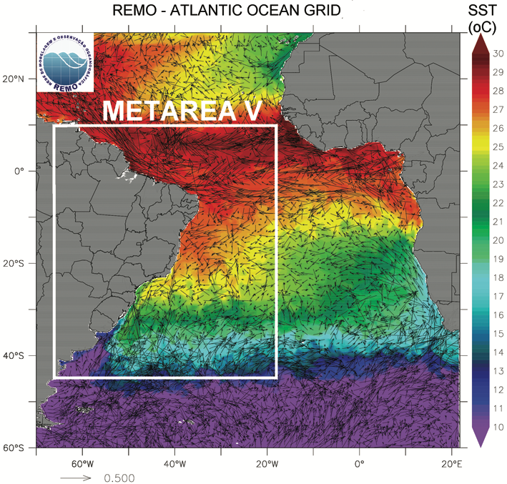
About SAR operations
Fig.1
Fig.2
Brazilian Navy
Lima et al. (2013)

Slide 6
About SAR operations
Fig.3
IMO

Slide 7
HYCOM-CHM Model as a auxiliar decision tool
Some simplifications
Climatology consideration (very important!)
Datasets and tracking script (Python)
Team work
Creativity

Slide 8
HYbrid Coordinate Ocean Model (HYCOM)
Table.1
Características | METAREA V | Atlântico | E | NNE | S-SE
Modelo Utilizado | HYCOM | HYCOM | ROMS | HYCOM | HYCOM
Malha Vertical (níveis) | 32 | 32 | 32 | 21 | 21
Resolução | 1/24° | 1/12° | 1/36° | 1/24° | 1/24°
Zamith (2020)

Slide 10
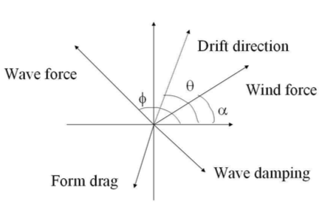
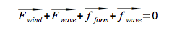
HYCOM-CHM Model as a auxiliar decision tool
Fig.4
Hackett, Breivik e Wettre, 2006

Slide 11
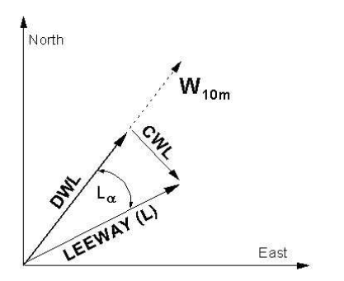
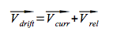
HYCOM-CHM Model as a auxiliar decision tool
Fig.5
Hackett, Breivik e Wettre, 2006

Slide 12
The Case Study
Fig.6
Liferaft (8 crew)
Brazilian Northest Coast
Last Know Position :
06° 21.08'S/033°45.02'W
Inicial datetime :
131041Z/JUN/2019
Rescue Position:
06° 09,6’S-034° 03,0’W
Final datetime:
140000Z/JUN/2019
Google

Slide 13
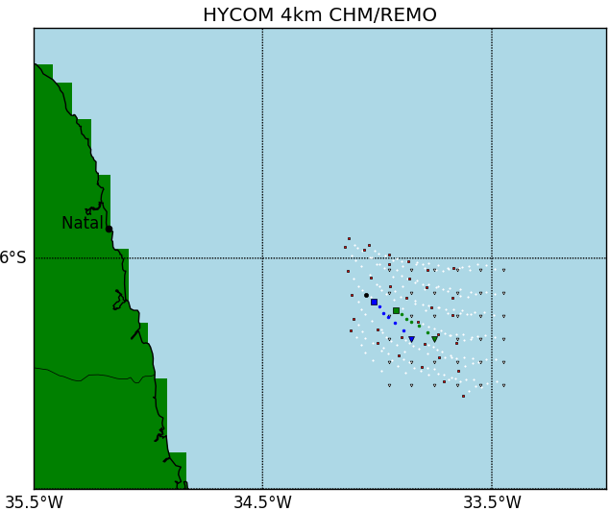
Results
Fig.7
Zamith (2020)
Time series == 13h

Slide 14
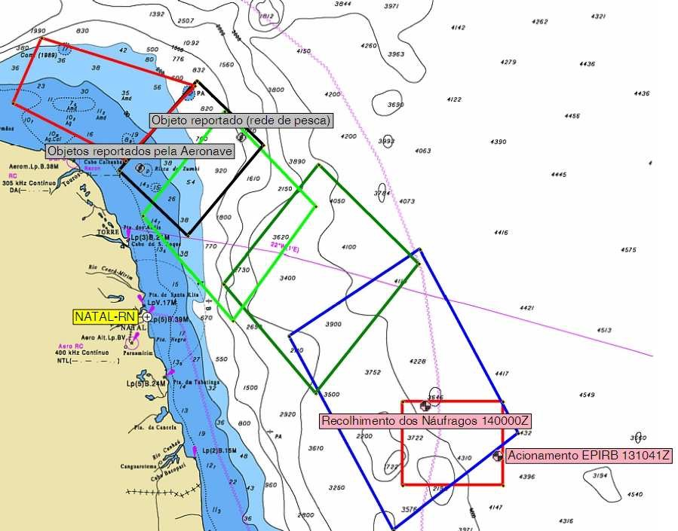
IAMSAR calculated areas...
Fig.8
SALVAMAR NORDESTE

Slide 15
Results
Observed x Positional residue simulation :
0.0206 degrees in latitude (approximately 2472 meters) and 0.0147 degrees in longitude, (approximately 1764 meters).
Contained in the SAR area 01( red smaller area – Fig 8)

Slide 16
Present and Future
Present : IAMSAR Manual
Future : SPAD-SAR as a Brazilian Particle Model specific to SAR Ops).

Slide 17
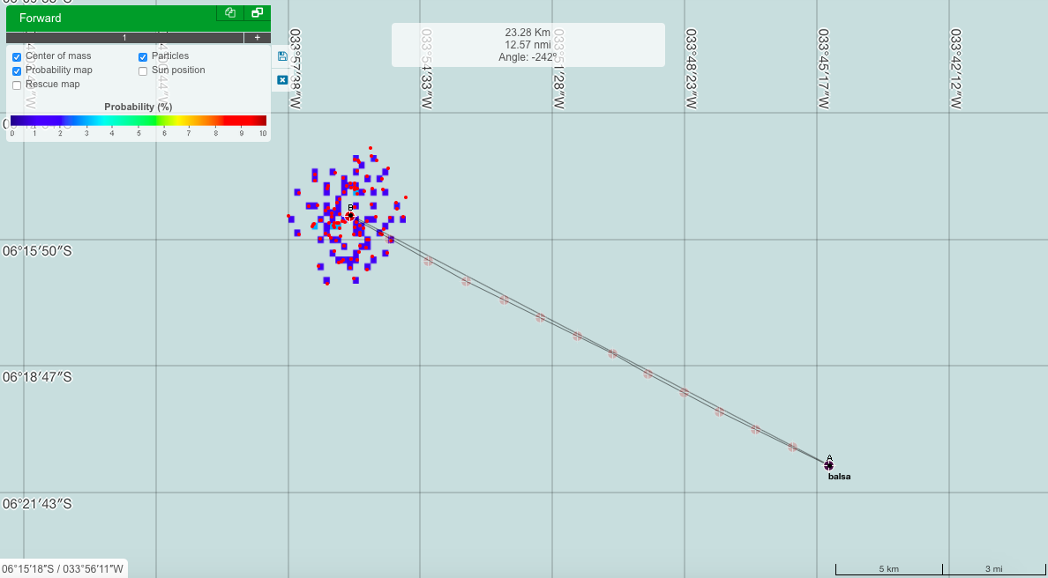
SPAD-SAR
Fig.9
PROOCEANO

Slide 18
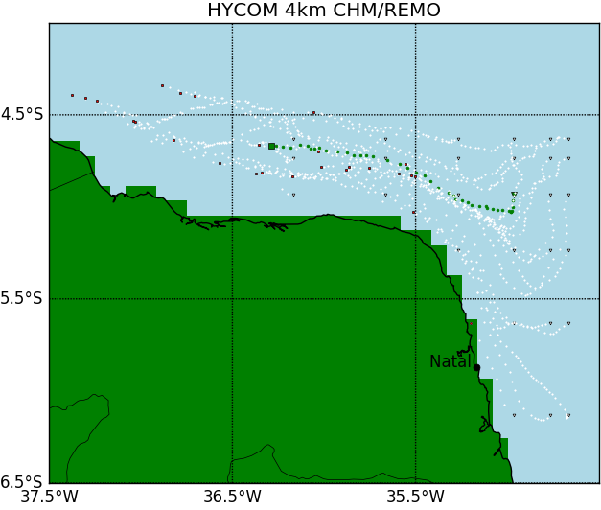
Time is the key
Fig.10
Zamith (2020)
Time series == 85h

Slide 19
Conclusion
A lot to study ...
Attention with simplifications **
Factor “time”
Motivate

Slide 20
Some Referencies
ALLEN, A.A; PLOURDE, J.V. Review of Leeway: Fields Experimentns and Implementation. US Department of Transportation, Washington, DC: US Coast Guard, 1999.
ALLEN, A. Leeway Divergence. U.S. Coast Guard Rep. CG-D-05-05, 128 pp.2005
FITZGERALD, R. B., D. J. Finlayson, and A. Allen, Drift of Common Search and Rescue Objects- Phase III." Contract report prepared for Canadian Coast Guard, Research and Development, Ottawa,1993.
HACKETT, Bruce; BREIVIK, Øyvind; WETTRE, Cecilie. Forecasting The Drift Of Objects And Substances In The Ocean. In: CHASSIGNET, Eric P.; VERRON, Jacques. Ocean Weather Forecasting. An Integrated View of Oceanography. Dordrecht, Holanda. Springer, 2006. cap. 23, p. 507-523.
LIMA, Jose A. M. PARKINSON, R. M.TANAJURA, C.PAIVA, Afonso de MCIRANO, M.Campos, Edmo J.D.SOARES, I. D.FRANCA, G. B.OBINO, R. S.ALVARENGA, J. B. R. . Design and Implementation of the Oceanographic Modeling and Observation network (remo) for Operational Oceanography and Ocean forecasting.Revista Brasileira de Geofísica (Impresso), v.31, p. 209-228, 2013
RICHARDSON, P.L. Drifting in the Wind: Leeway error in shipdrift data.Deep Sea Research I, Great Britain,vol.44 n.11,pp.1877-1993,1997.
Modelling_Search_and_-Rescue. (My GitHub). Disponível em <https://github.com/Z-metoc/Modelling_Search_and_-Rescue>

Slide 21
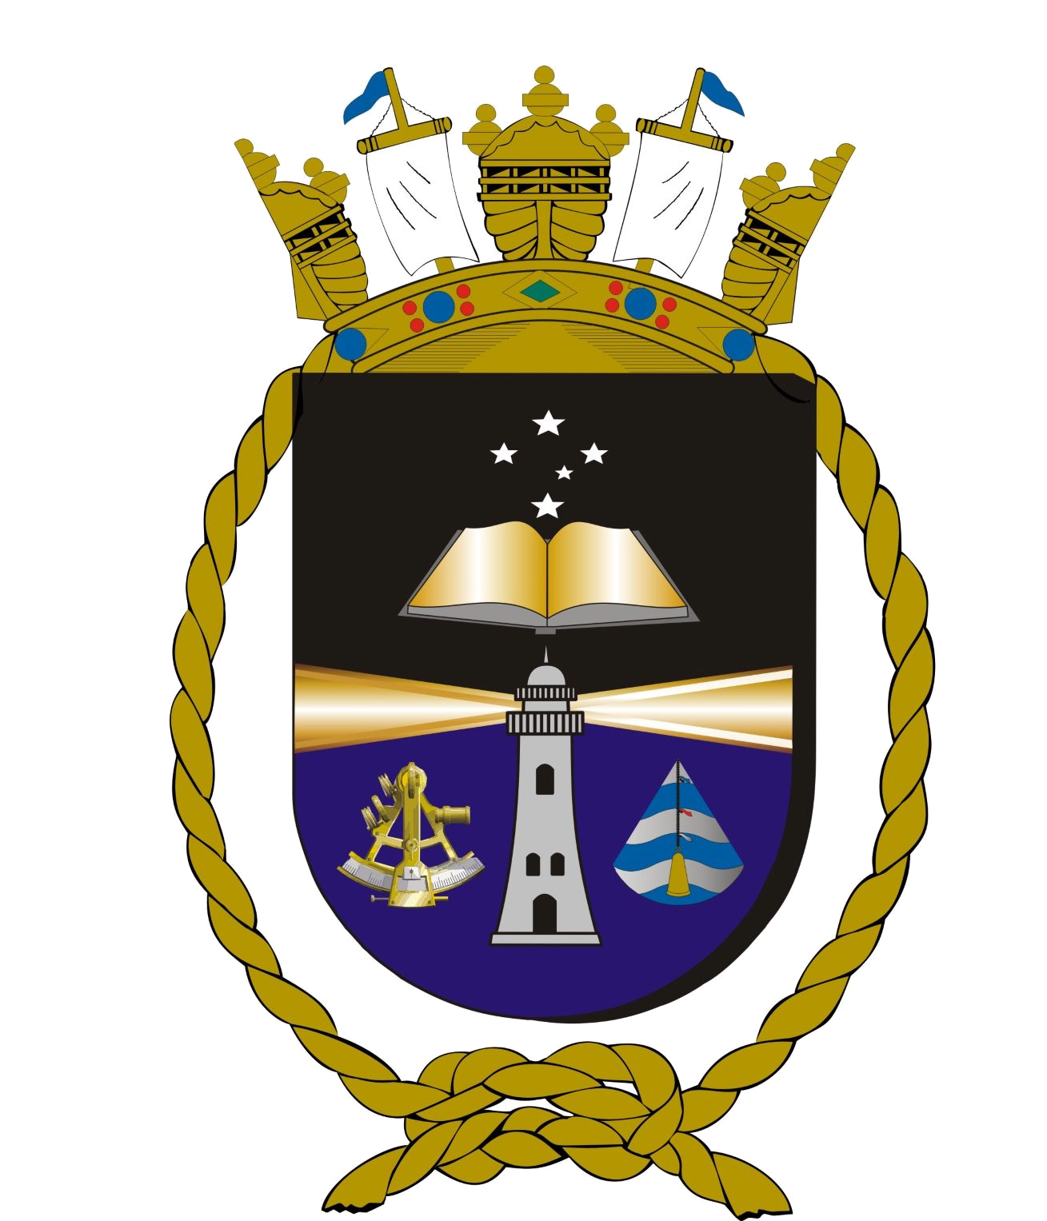
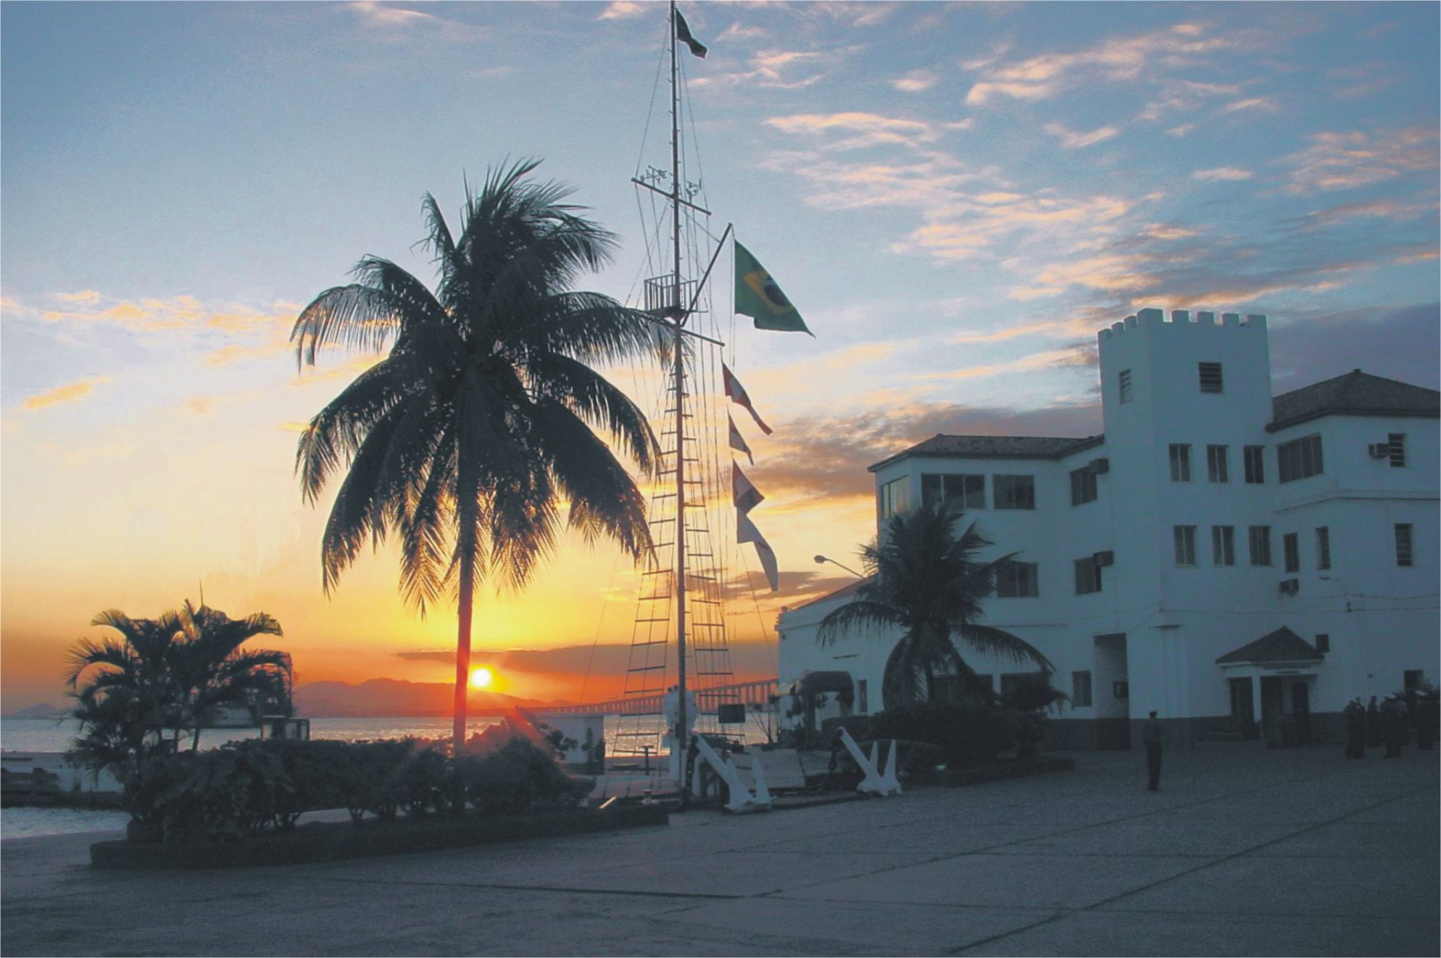

There is always a lot to do ...
Thank you!
Notes:
21
21

